Slide 1
NETWORKING
Data communication involves the transfer of information from one computer to another.
This transfer is controlled by communication devices and communications software.
A communication device is any component or piece of hardware that assists in the transfer of data.
  For example, modems, and cables are all communications devices.

Slide 2
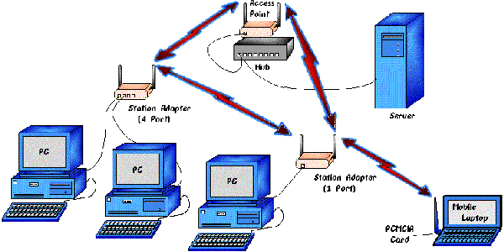
WHAT IS A COMPUTER NETWORK?

Slide 3
WHAT IS COMPUTER NETWORK
A Computer Network is a group of two or more independent computers connected in an organized manner such that they can communicate with each other.
Computers and peripherals on a network are sometimes called nodes.
Intranet: computer network, based on Internet technology, that is designed to meet the internal needs for sharing information within a single organization or company.

Slide 4
Extranet: An extranet is a private network that uses the Internet protocols and the public telecommunication system to securely share part of a business's information or operations with suppliers, vendors, partners, customers, or other businesses. An extranet can be viewed as part of a company's intranet that is extended to users outside the company. An extranet requires security and privacy

Slide 5
WHY A COMPUTER NETWORK?
The main reasons are:
Share resources
  share Remote I/O Devices. Users can share printers and telecom services
  Share Remote Data/File Access. Centrally stored company databases are available to all users of the LAN
  communications (like e-mail, chat, audio/video conferencing). Users can communicate throughout the LAN using e-mail.

Slide 6
Reasons/advantages
Distribute pieces of computation among computers (nodes). Applications installed on certain nodes are accessible
No security issues of illegal aces if implemented with centralized control
scalability-ability to grow
flexibility
Cost effective in long run

Slide 7
Disadvantages of Computer Networks
Network Architecture management
  The organisation has to pay technical staff to maintain the network.
Disk space management.
  users' data is stored on the servers hard drives need to be backed up regularly or there would be a public outcry if it were lost. Each user is allocated a specific amount of space on the hard drive, they exceed it and moan for more
Resource management.
  Networks fail occasionally and then no one in the organisation can use the computers. As more users log onto the network, the servers have to share their time among them and the system may slow down

Slide 8
Disadvantages
Security issues – data and information held on the network is prone to more illegal access threats if implemented using decentralized control than if the computer was not on the network.
Over-reliance on networks – if by any chance the network fails or goes down, then all system in the organization will be brought to a halt

Slide 9
Disadvantages
High in initial cost – the initial of buying network hardware and software is very high
Moral and cultural effects – large network like internet have chatrooms and messaging services that enable under age children to meet peers and adults on the net some of whom may have bad intentions. E.g. access to phonographic

Slide 10
Networks
We can have two types of networks (configurations).
Client/server network where we have one server and many clients.
Peer-to-peer network – all computers have the same capability and can communicate with each other

Slide 11
Area of location
LANs : Local Area Networks
Typically connects computer in a single building or campus OR is a network that is confined within a building. Rarely are LAN computers more than a mile apart.
On most LANs, cables are used to connect the network interface cards in each computer.
  Medium : optical fibers, coaxial cables, twisted pair, wireless.
It does not require remote communication facilities such as modems and telephones if digital

Slide 12
Area of location
MANs: Metropolitan Area Networks
  Generally covers towns and cities
  Medium : optical fibers, cables.
  Data rates adequate for distributed computing applications.
WANs : Wide Area Networks.
  Generally covers large distances (states, countries, continents).
  Medium : communication circuits connected by routers,cables(eg optic fibre) or wireless

Slide 13
Differences between LANs & WANs
COST- LANs are cheaper to set up and maintain while WAN are expensive
AREA COVERED –LANs are limited in distance covered like in a city /campus while WANs have no distance limit coverage like continent to continent etc.
SPEED. LANs offer high speed data rates due to short distances involved unlike WAN which long distance affect data rate speed by lowering it

Slide 14
Differences between LANs & WANs
Administration/ownership-LANs are controlled and owned by one organization with one administrative authority while WAN IS owned by third party which can be one entity or several entities with working arrangement

Slide 15
NETWORK TOPOLOGIES

Slide 16
Topology
In Computer Networking “topology” refers to the layout or design of the connected devices.
Refers to the configuration of cables, computers, and other peripherals
Network Topologies can be physical or logical.
They include the following.
    1. Star Topology 2. Bus Topology
    3. Ring Topology 4.tree topology

Slide 17
Star Topology
A star topology is designed with each node (file server, workstations, and peripherals) connected directly to a central network hub or concentrator
Data/messages on a star network passes through the hub or concentrator before continuing to its destination
.

Slide 18
Star Topology
The hub or concentrator manages and controls all communication functions of the network.

Slide 19
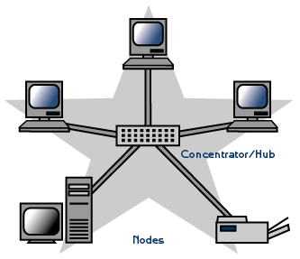
Star Topology

Slide 20
Star Topology
Advantages
Easy to implement and extend, even in large networks
Well suited for temporary networks (quick setup)
The failure of a non central node will not have major effects on the functionality of the network.
Easy to detect faults and to remove parts.

Slide 21
Disadvantages of a Star Topology
Requires more cable length than a linear topology.
If the hub or concentrator fails, nodes attached are disabled.
More expensive in maintenance in long run because of the cost of the concentrators.
Limited cable length and number of stations

Slide 22
BUS Topology
consists of a main linear /BUS of cable with a terminator at each end.
All nodes are connected to the linear cable.
All nodes may directly communicate with each other
we use the coaxial cable to connect the workstations

Slide 23
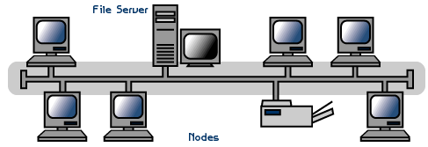
BUS Topology

Slide 24
Advantages
Easy to implement and extend
Well suited for temporary networks (quick setup)
Typically the cheapest topology to implement
Failure of one station does not affect others

Slide 25
Disadvantages
Difficult to administer/troubleshoot
Limited cable length and number of stations
A BUS/BACKBONE cable break can disable the entire network
Maintenance costs may be higher in the long run
Performance degrades as additional computers are added

Slide 26
Tree Topology
This combines characteristics of linear bus and star topologies. Also called hybrid topology
consists of groups of star-configured workstations connected to a linear bus backbone cable
The topology allow for the expansion of an existing network, and enable schools to configure a network to meet their needs.

Slide 27
Tree Topology
if a single computer fails, it will not affect the rest of the network

Slide 28
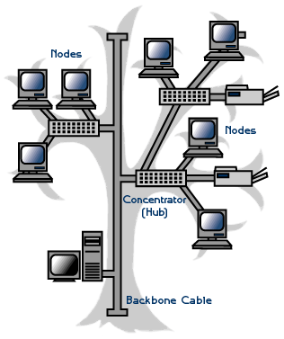
Tree Topology

Slide 29
Tree Topology
Advantages of a Tree Topology
Point-to-point wiring for individual segments.
Supported by several hardware and software venders.
Disadvantages of a Tree Topology
Overall length of each segment is limited by the type of cabling used.
If the backbone line breaks, the entire segment goes down.
.

Slide 30
Tree
More difficult to configure and wire than other topologies

Slide 31
Ring Topology
Computers are connected on a single circle of cable/in circular manner.
Here every node is connected to two other nodes
Though its two way direction, the signals travel around the loop in one direction for particular transmission selected using source and destination address(-shortest direction) to prevent signals from interfering with each other

Slide 32
Ring Topology
Signals pass through each computer, which acts as a repeater to boost the signal and send it to the next computer
A token is a special series of bits that contains control information.
Each network has only one token and Possession of the token allows a network device to transmit data to the network.

Slide 33
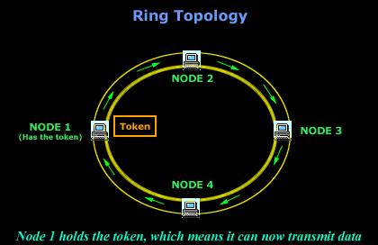
Ring Topology

Slide 34
Advantages
Growth of the system has minimal impact on performance .
Failure of one node does not impact others because of two rings (primary & secondary) fault tolerance attribute
All stations have equal access
Each node on the ring acts as a repeater, allowing ring networks to span greater distances than other physical topologies.
Network has one token and to transmit device has to grab it so no collisions
Because data travels in one direction high speeds of transmission of data are possible

Slide 35
Disadvantages
Often the most expensive topology

Slide 36
Network Protocols:
A communication protocols is a set of rules that ensures the orderly and accurate transmission and reception of data. The most widely used network communications protocol are:
1.TCP/IP (Transmission control protocol/Internet protocol) which is used on minicomputer, micro computer and mainframe networks.

Slide 37
Network protocols
It is frequently used in UNIX and Win. NT systems and is the basis for a communication on the network
2. IPx (Internet-work packet exchange) is the protocol used by Novell NetWare, the most popular microcomputer network software.

Slide 38
Network Hardware for LAN
Network interface card (NIC) This is the key hardware component for connecting a computer to a LAN. It is a small circuit board designed to plug into an expansion slot on a computer main-board.
Provides the physical connection between the network and the computer workstation.The NIC sends data from your workstation out over the network and collects incoming data for your workstation. Most recent computers have them integrated onto the motherboard

Slide 39
Network Hardware for LAN
2. Connecting cables:- The cables commonly used for interconnecting PCs are the twisted pair copper wires, either Category 5 (CAT 5) or Category 6 (CAT 6) cables. Or fiber optic connections. Instead of using cables, some wireless networks use radio or infrared signals to transmit data from one network device to another. The NIC on a wireless network contain the transmitting device necessary to send data to other devices on the LAN.

Slide 40
Network Hardware for LAN
3. Network Servers
  The server controls the communication of information between the nodes on a network.
  The network operating system software resides on this computer, along with any software applications and data files that need to be shared.
These are different kinds of network servers.

Slide 41
SERVERS
A dedicated file server is devoted only to the task of delivering programs and data files to workstations. It does not process data or run programs for the Workstations. Instead programs run using the memory and processor of the workstation.
Non-dedicated server (peer-to-peer capability) here a network computer performs a dual role as both file server and workstation

Slide 42
Other servers in networks
Print server – stores files in a print queue and sends each queued file to the network printer. A print job is a file that has been sent to the printer
Mail server

Slide 43
Networking hardware
4.Workstations-All the computers connected to the servers on a network.
5.Modem- ref to communication devices

